Slide 1
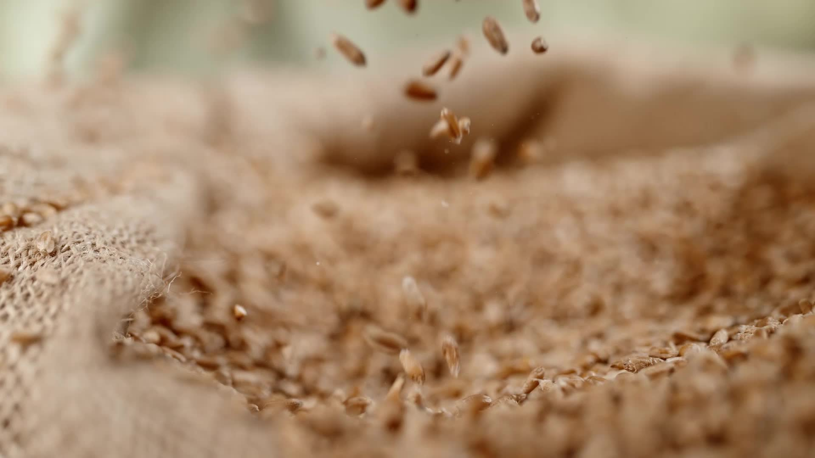
Rice GRAIN Counter
Image Processing BITI3313 Final Project
Elle Aliz Binti Aminuddin B031810295 |Thitthima A/P Wat B031810361

Slide 2
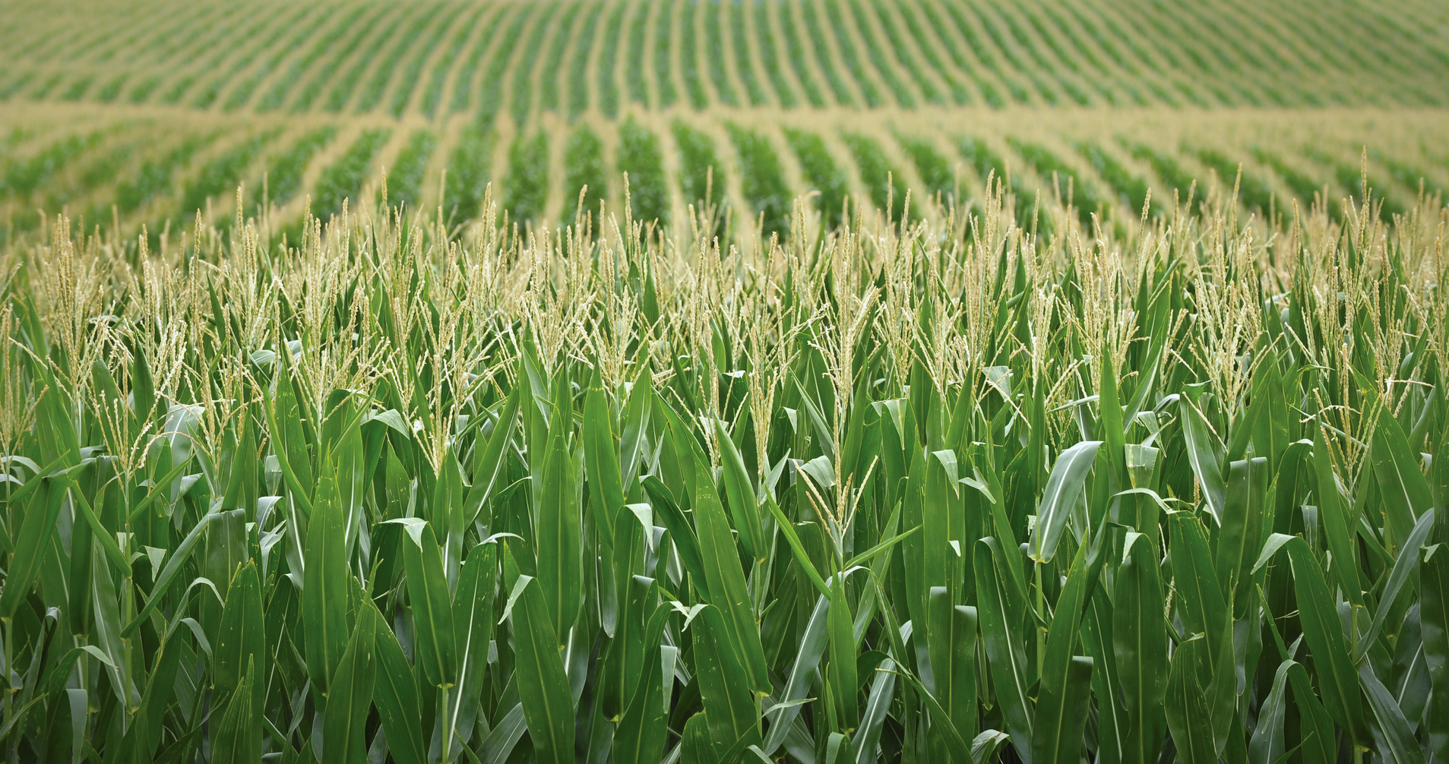
Introduction
Crop yields largely depend on the number of grains per spike and the thousand grain weight
Therefore, thousand grain weight is considered an important parameter for the effective evaluation of cultivation measures and variety breeding
It is a measurement indicator frequently used in crop research.
Counting is the first step in the measurement of thousand grain weight.
This Photo by Unknown author is licensed under CC BY-NC-ND.

Slide 3
Introduction
Problem Statement
Manual counting is laborious and time consuming. Human eyes may be tired and thus cause errors.
How to identify the standard rice grain.
Objective
To count individual rice grains.
To find the defective rice grain size.
Image Processing concept to be used
Intensity Transformation (Contrast)
Binarize Image
How to differentiate the defective rice grain.
To identify the total number of rice grain that fits the standard in a certain quantity.
Segmentation (Edge Detection)
Color

Slide 4
Methodology

Slide 5

Coding & system Demonstration

Slide 6
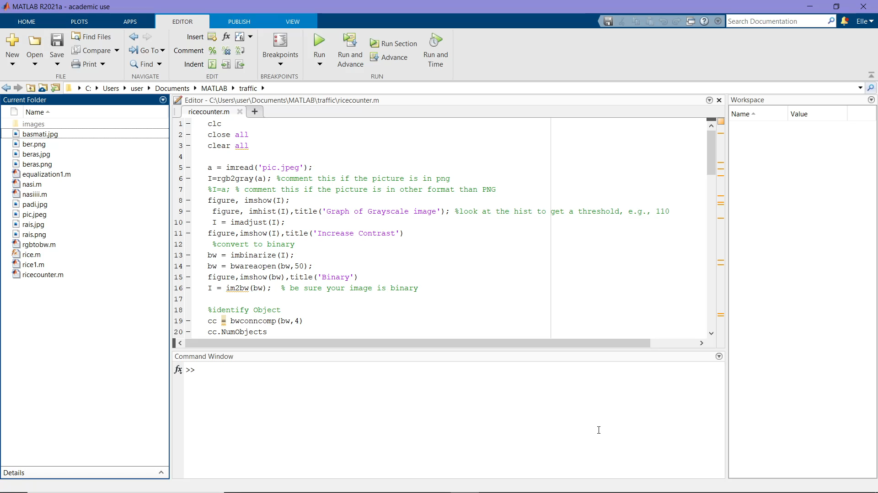

Slide 7
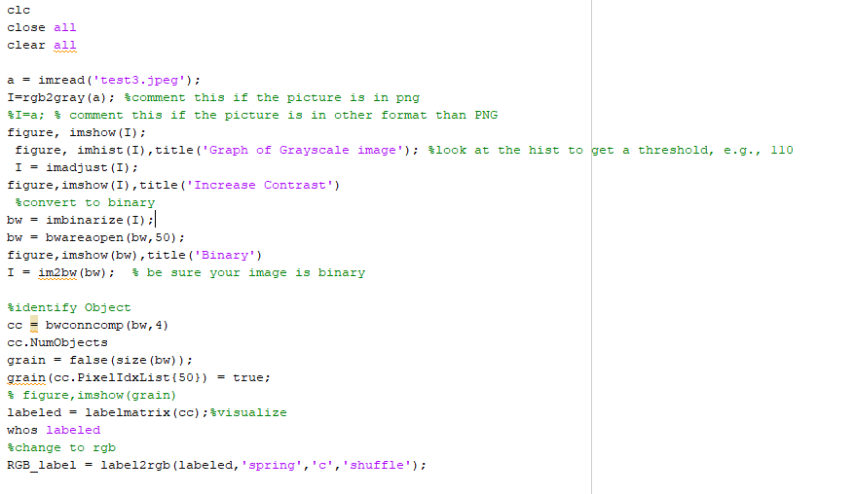
MATLAB Coding

Slide 8
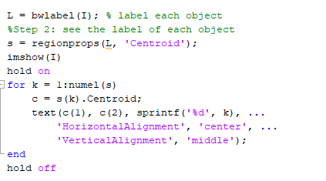
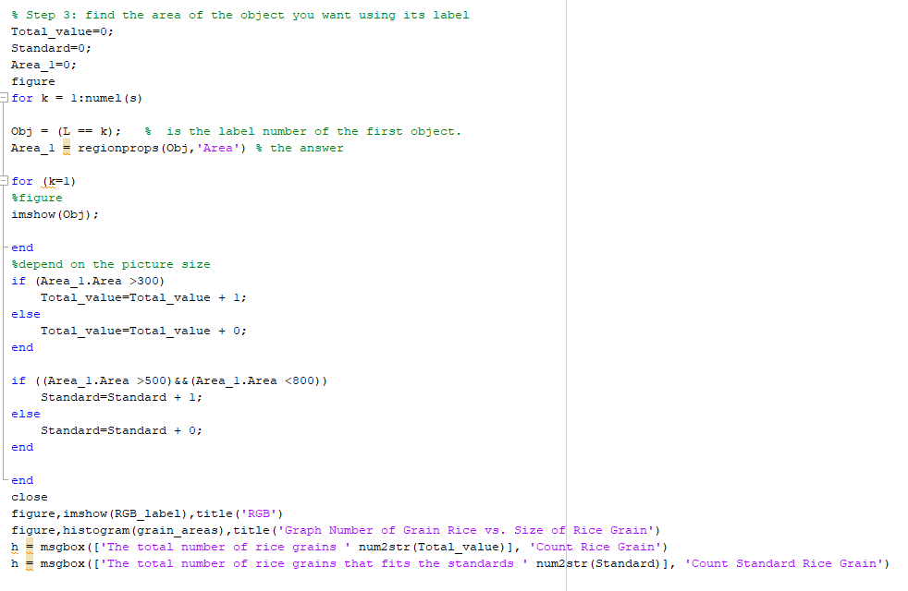

Slide 9
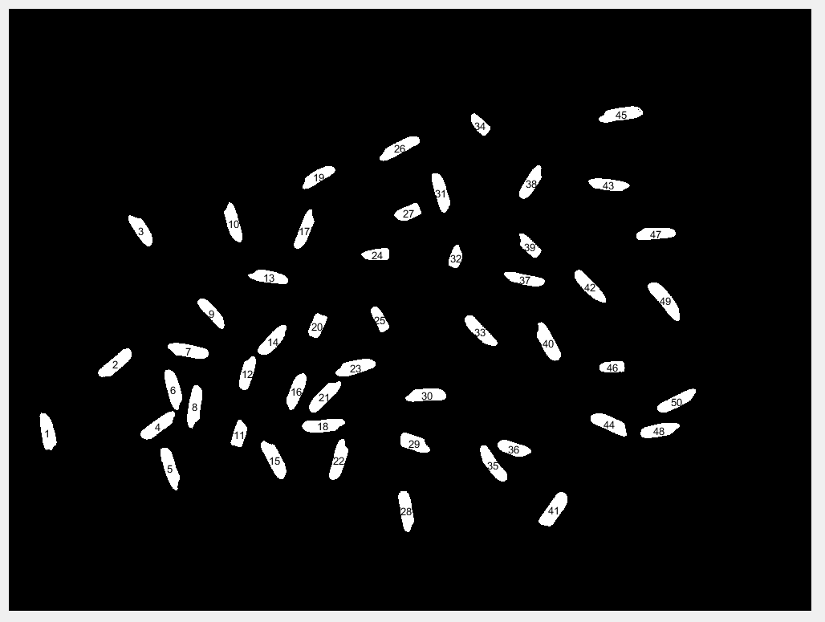
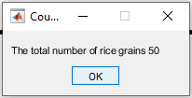
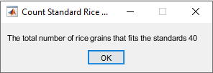
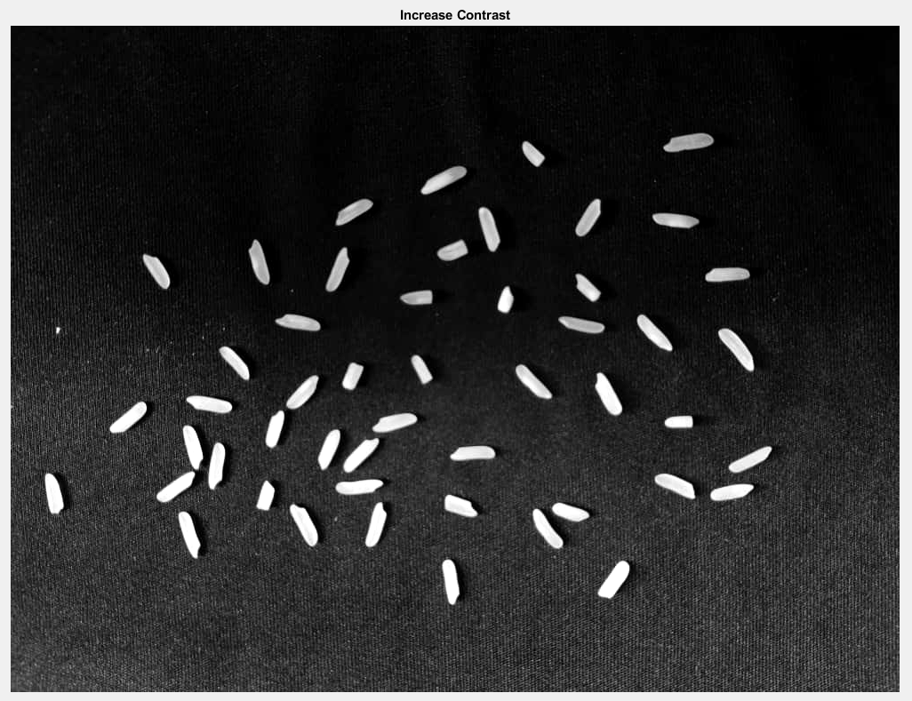
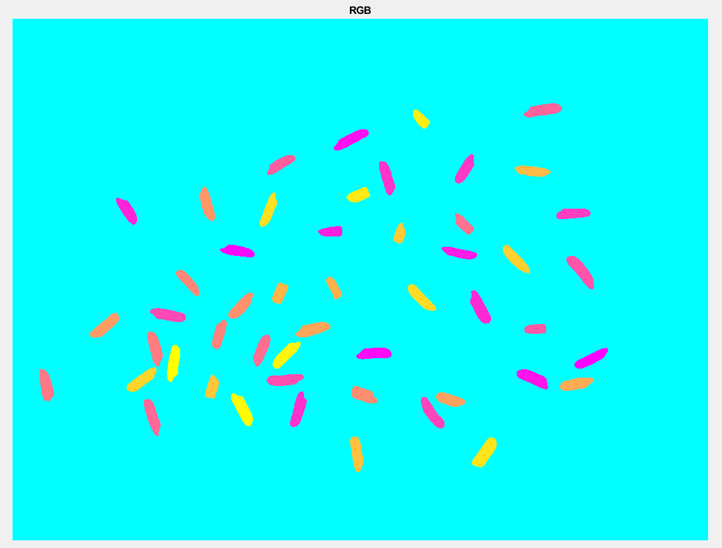
Results
Labeled Rice Grain
Increase Contrast
Change to RGB

Slide 10
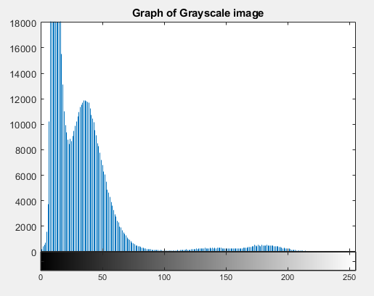
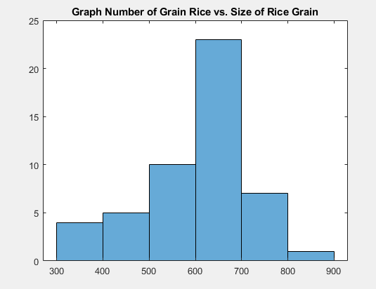
Analysis

Slide 11
Advantages & Disadvantages
Advantages
Can detect more than one type of rice grain (eg: basmati, black rice)
Can differentiate defective rice grains from the faultless rice grains
Disadvantage
Unable to detect rice grains if too close to one another

Slide 12
Constraints while doing the project
Coding needs to be altered according to different type of image file
Limited access to various kinds of rice grains

Slide 13

Thank you

